Slide 1
Time Series Forecasting of ECG using Transfer Learning & Heart Arrhythmia Detection

Slide 2
The Problem at Hand
With digitization of ECG signals, there is large amounts of data being generated using different type of ECG sensors including the portable ECG measurement devices like watches.
To exploit the full potential of this large amounts of data being generated, there is need to develop models that can analyse this data and find useful insights. It isn’t practically possible for single person or even group of persons to analyse the data at the speed and volume at which it is being generated.

Slide 3
Solution Proposed
Trained an LSTM network using Transfer learning for time series forecasting of ECG signals.
The LSTM network was first pretrained on the ICENTIA 11K ECG dataset followed by finetuning on the downstream data set.
The predicted Signals are fed to a neural network which classifies the beat types (PVC,PAC,Normal) of signal.
Another neural network is also used for layman analysis (1/0) classification. 1=Anomalous Beat 0=Non Anomalous Beat

Slide 4
What is Time Series Forecasting & Transfer Learning?
Time Series Forecasting involves prediction of future values of a time series.
Time series forecasting applications involve Stock Prices predictions, GDP Predictions amongst others.
Time Series Forecasting in Healthcare can help with important insights that can save patients life’s.
Transfer Learning is an approach that focuses on gaining knowledge from one task and then using this knowledge in another related task.
Transfer Learning is particularly useful when the data for model training is scarce.

Slide 5
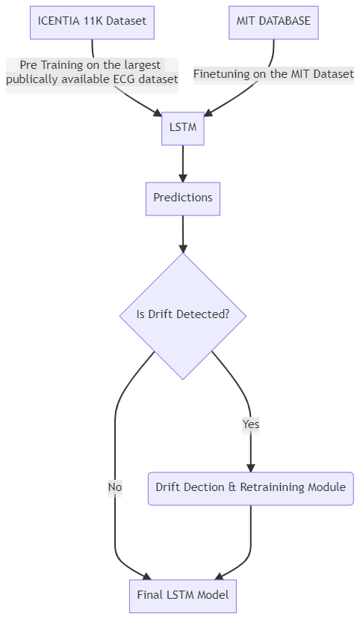
Process Flow

Slide 6
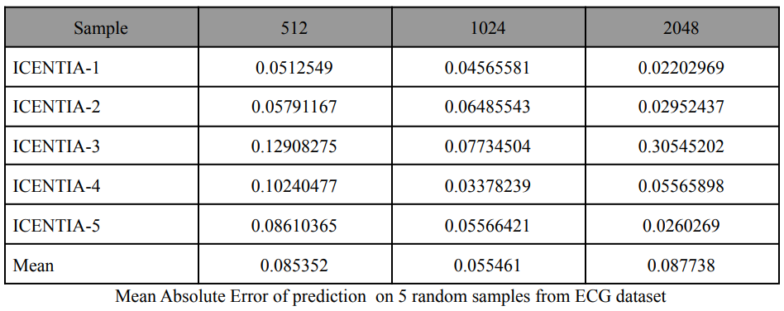
Diving Deeper into the Proposed Solution
The first part of the experiment involved training LSTM on three different window sizes (512,1024,2048). Window size can be considered as the context or the values that LSTM will take into account to predict the next value.
The sampling frequency of the dataset is 250Hz so these samples are approximately 2,4 and 8 seconds long respectively.
We figured out that at a window size of 1024 i.e. for samples 4 seconds long, the mean absolute errors of predictions were least. So all the models discussed hereafter consider the window size as 1024

Slide 7
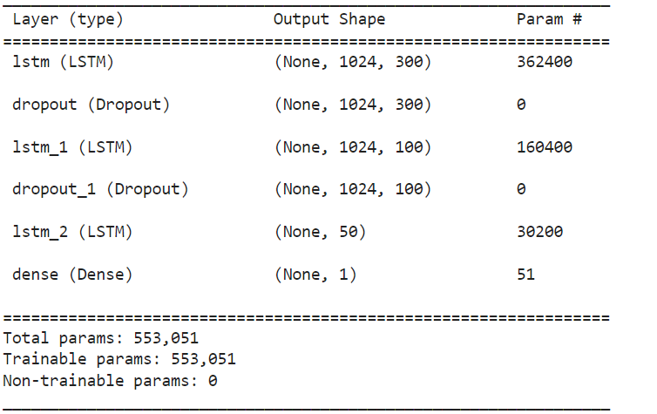
Discussion Around LSTM Model Architecture
Tried different LSTM model architectures with upto 3 stacked LSTM layers, and different number of neuron units in each and chose the one considering both accuracy and training time.
In between the three LSTM layers we also have a drop out layers with a dropout factor of 0.2. This helps decorrelate the weights of the neurons. And prevents overfitting as all the neurons are not synchronously updating their weights.

Slide 8
Transfer Learning & Finetuning the Model
The first major issue with transfer learning is the inherent nature of sampling of ECG signals. Different devices as we had discussed in the beginning sample at different frequencies.
In our case the dataset used for finetuning is the MIT dataset which essentially is sampled at 360Hz compared to the 250Hz sampling of Icentia 11K.
To ensure that our pretrained model is not to be discarded decimated the MIT dataset signals to 250Hz using python libraries.
While finetuning the model, it was observed that some samples gave a large value of loss function, to correct this to some extent, we’ve used a novel approach which combines two drift detectors and predicts out the regions of high error on the samples where model must be retrained.

Slide 9
Incremental Learning using Drift Detection
We first freeze all but the last layer of our model to capture signal specific features only. So only the wights of last layer will be updated in this step.
We use the LSTM trained in the model in previous step to forecast values for some of the signals. Based on the obtained predictions we create a binary sequence which has 1 at ith position if the error in prediction for the ith value exceeds a certain threshold else 0.
In this step we use a custom drift detector which combines the findings of two drift detectors (DDM & HDDM).
The binary sequency is fed into the custom drift detector which returns the region where drift in errors is detected by both DDM & HDDM. The model is retrained on those particular regions.
This selective retraining saves time and computation power.

Slide 10
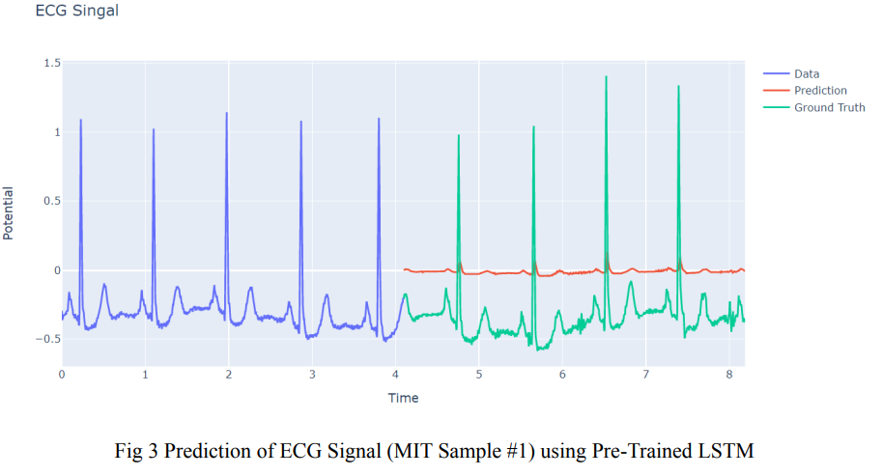
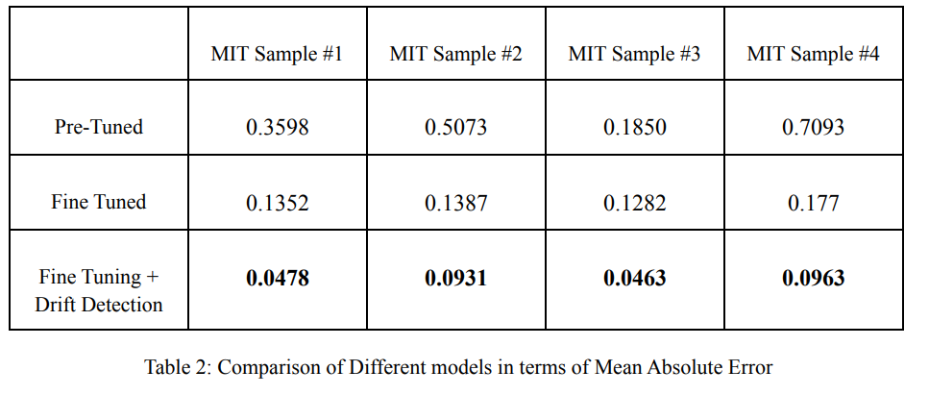
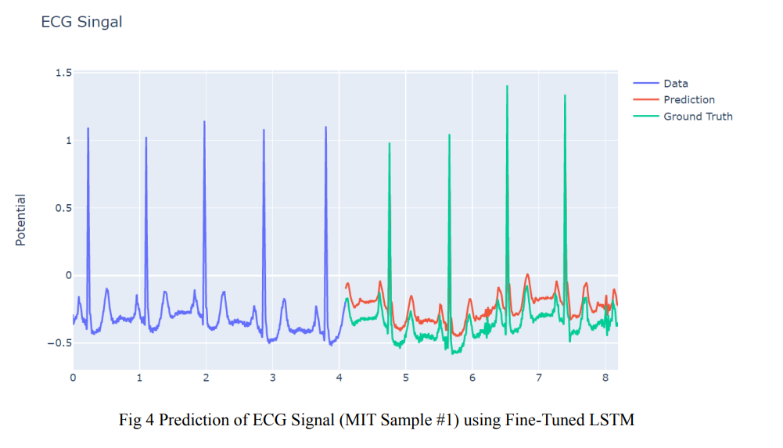
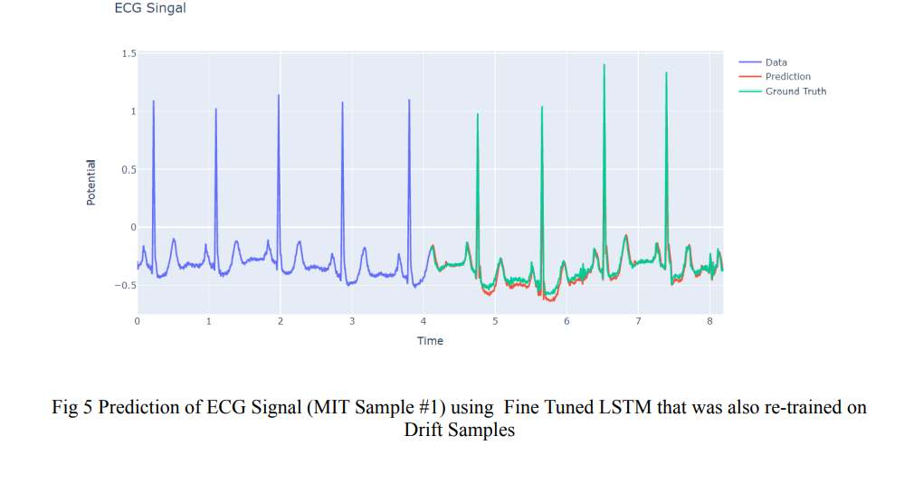
Quantification & Visualization of Improvement

Slide 11
Arrhythmia & Heart Rate Detection
We also perform the task of beat classification for the predicted signals using a Convolution Neural Network.
There are three classes in which the beats are classified, i) Normal ii)PAC and iii)PVC
This classification we observed was hard to understand for anyone not connected with medical filed and did no value addition for them, so we trained another neural network as well which group the abnormal classes i.e. PAC & PVC into one single class anomalous beat types. This makes it easier for the patient to understand. We perform binary classification here (1(Anomalous)/0(Normal))
Thus we cater to both patients & physicians.
We also calculate the heart rate from the predicted using ECG signal.

Slide 12
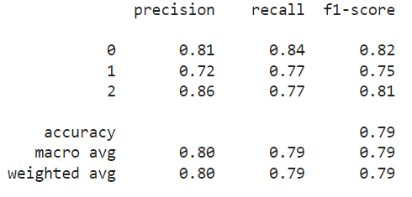
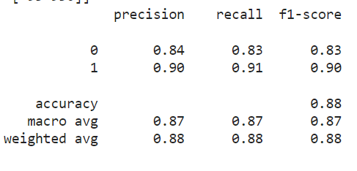
Quantifiable Metrics from the model
3 Class Classification
Binary Classification

Slide 13
Conclusion
In this work, we showed how transfer learning is an effective technique for the time series prediction of ECG signals. We believe the pre-trained model compared to others will generalize better to unseen data in real-world scenarios. It was found that drift detection & retraining the model for the points identified as drift points can improve the model performance.
As for the future scope of work, we may try different approaches like ARIMA, AIMA with transfer learning and compare the performances with LSTM. One may also try different drift detection approaches & figure out the one which reports the critical points with high precision continuously.

Slide 14
Acknowledgement
I have tried my best to present this state of the art report in a complete manner
without failing the deadlines. However, it would not have been possible without
the kind support and help of many individuals. We would like to extend our sincere
thanks to all of them.
I am very highly indebted to Dr. Sonali Agarwal Ma’am & Sadhna Ma’am for their guidance and constant supervision as well as for providing necessary information concerning to
implementation. I am very thankful to them for their support in this comprehensive
in-depth study.

